Slide 1
Taking a Deeper Look at
Co-Salient Object Detection
Deng-Ping Fan^{1,2} Zheng Lin¹ Ge-Peng Ji³ Dingwen Zhang⁴ Huazhu Fu² Ming-Ming Cheng¹ ¹Nankai University ²Inception Institute of Artificial Intelligence ³Wuhan University 4Xidian University
Notes:
Here is the brief introduction about our work “Taking a Deeper Look at
Co-Salient Object Detection”.

Slide 2
What is Co-Salient Object Detection?
Notes:
What is Co-Salient Object Detection?

Slide 3
Find Common Salient Object
Notes:
The task aims to find common salient objects in a sequence of images.

Slide 4
What are the contributions?
Notes:
What are the contributions?

Slide 5
Present a new dataset (CoSOD3k)
Notes:
Firstly, we present a new dataset, named after CoSOD3k.

Slide 6
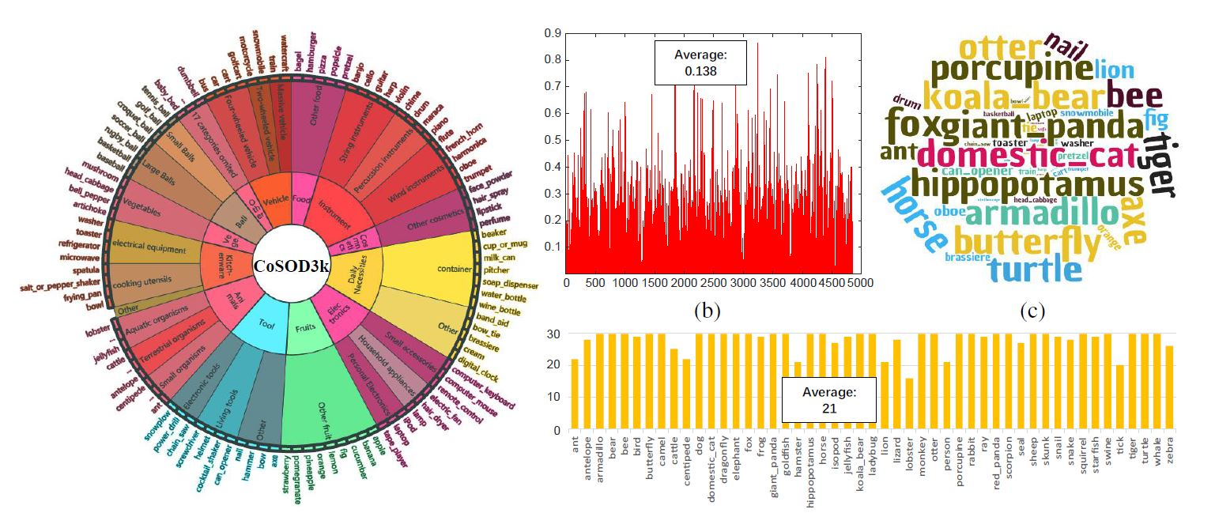
New Dataset: CoSOD3k
Rich categories, precise annotations, detailed statistics
(3316 images, 13 categories, 160 subcategories)
Notes:
The dataset contains rich categories, precise annotations. We also provide detailed statistics about it.

Slide 7
Category
Bounding box
23, 938
39, 498
23, 938
Object-level label
Instance-level label
Notes:
Here are some examples in the dataset and there are four kinds of annotations.

Slide 8
Provide the detailed overview
Notes:
Secondly, we also provide a detailed overview about previous works in this area.

Slide 9
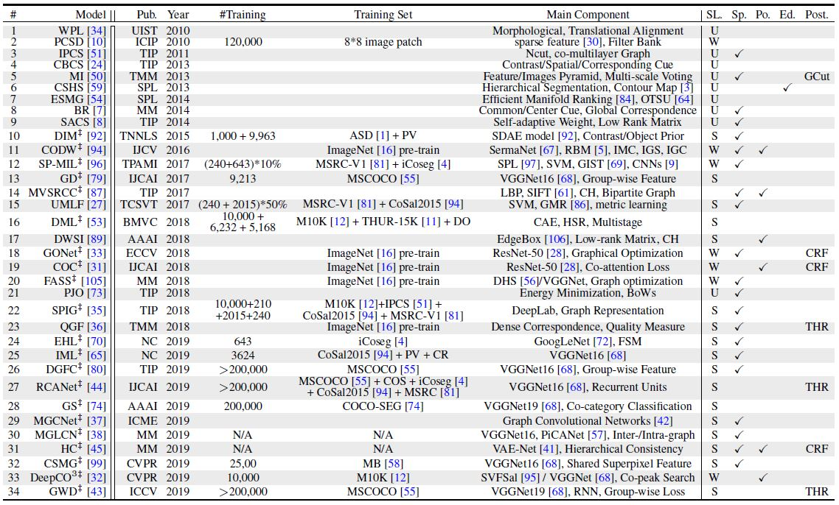
Notes:
Here shows the detailed overviews of 34 representative models.

Slide 10
Provide the largest-scale benchmark
Notes:
What’s more, we also provide the largest-scale benchmark, covering most datasets and methods.

Slide 11
Notes:
Here are some examples.

Slide 12
Download
free
All datasets (include CoSOD3k).
All saliency maps of all methods.
Benchmark tools for evaluation.
Pre-evaluated methods scores.
http://dpfan.net/CoSOD3k/
Notes:
It is free and contains all kinds of useful information in the area of co-salient object detection. Welcome to download for research!

Slide 13
Thank You!
Email: dengpfan@gmail.com
WeChat
Notes:
Thank you!

